Slide 1
Numbers and concepts

Slide 2
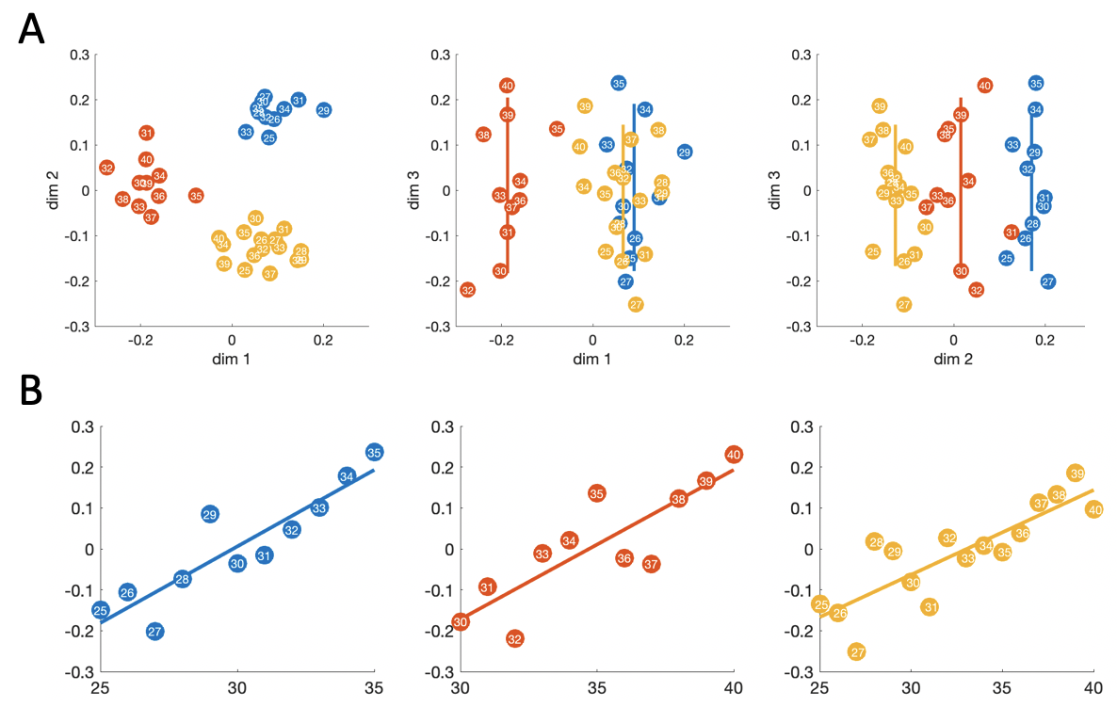
Fabrice’s next tattoo (EEG)

Slide 3
A simple network model
input A
(15 unit one-hot)
…
“is input A > input B?”
input B
(15 unit one-hot)
…
FC
…
0-1 output
False if < 0.5
FC
context
(3 unit one-hot)
…
60 reLu units

Slide 4
Lets train without context (NN)
Sequential trial structure, input A on trial t becomes input B on trial t+1
24 pseudorandomly ordered blocks across 3 contexts (8 blocks each), but context is always input
as one-hot representation of 1. ie. no explicit context marker.
We test the hidden activations post-training, so we lose the sequential structure at test
(so there is NOTHING to indicate context).
60-unit activations averaged over input B (previously shown number), labeling by input A
No obvious extra pattern linking 1-5, 5-10 and 5-15 which could (?) maybe have resulted from
differences in presentation frequency, instead just see one long magnitude line at test.

Slide 5

Lets train without context (NN)
Remember that MDS dimensions are not necessarily orthogonal, and there is randomness in the initialisation of the fitting process, so the MDS will not look exactly the same each time it is fit.

Slide 6
Our matching tattoo (NN)
Sequential trial structure, input A on trial t becomes input B on trial t+1
24 pseudorandomly ordered blocks across 3 contexts (8 blocks each)
Context explicitly labeled as a separate one-hot input
As before, averaging hidden unit activations over input B (previously shown number),
labeling by input A
Magnitude lines are clear and parallel-looking across contexts, but separated by context
The higher range context has a longer-looking magnitude line

Slide 7
Our matching tattoo (NN)
MDS projections are magnitude mean-centred within each context = what you get if you have a difference (A-B) representation (what we see in the full A,B representations)

Slide 8
Our matching tattoo (NN)
RDM also looks to me like absolute magnitude coding to me
(see position of pale diagonals), but there is also a smooth relative code in there too

